Slide 1

3
Project
Sprint

Slide 2
Index
1
4
Deployment scenario of the solution
Results achieved
2
Critical analysis of results and teamwork
5
Quality of the final product
3
6
Evidence of applying the software engineering/development process
Suggestions of improvement

Slide 3



Results achieved
Our team has produced and deployed a software solution that satisfies the project's requirements successfully. Our objectives were fulfilled, and the product delivered on schedule. As a result, we developed eCourse, a new platform for distant learning, with the following primary goals:
Collaboration technologies such as ShareBoard/Meetings enable user interaction and conversation. The SharedBoard is viewable and editable by all users.
Enrollment requests
Preview of upcoming activities (exams, classes...)
User GeneratedExam Design and Validation
Creation of courses
Students can use the app to take examinations

Slide 4

Critical analysis of results and teamwork
We used the SWOT analysis to evaluate our team's strengths, weaknesses and opportunities. Our technical know-how and solid communication abilities are some of our capabilities. We are aware of our shortcomings as well, though. One of them is the fact that we lack expertise in several areas.
Notes:
O nosso projeto teve como objetivo criar uma solução inovadora e eficaz para o problema que nos foi apresentado. Para isso, seguimos os seguintes passos:
- Primeiro, a nossa equipa começou por compreender quais eram os requisitos específicos, sendo este um passo importante, uma vez que nos permite compreender o que pretendemos alcançar enquanto equipa.
- Após este passo, foi efetuada uma investigação aprofundada do público-alvo e das propostas já presentes no mercado. Desta forma, pudemos identificar as necessidades e as expectativas dos potenciais utilizadores.
- A equipa decidiu utilizar uma metodologia ágil para o processo de desenvolvimento, o SCRUM. Esta abordagem da equipa permitiu-nos garantir que o processo de desenvolvimento é iterativo e colaborativo, dividindo assim o projeto em tarefas mais pequenas que são realizadas em sprints, permitindo-nos obter feedback do utilizador ao longo do processo e entregar um produto final funcional num menor espaço de tempo, correspondente com os nossos padrões de qualidade.

Slide 5



Evidence of applying the software engineering/development process
As a team, we adhered to a formal software development process throughout the entire project. To guarantee timely delivery and incorporate user feedback into the final product, we adopted agile approaches. With this strategy, we were able to quickly adjust to shifting needs and create a great product that satisfied our customers. We were able to continuously improve our processes and complete a successful project by regularly monitoring our progress and getting input from stakeholders.

Slide 6







Deployment scenario of the
solution
The software solution was created locally, but the database utilized for its specific operation is online, allowing any system running our program to access it. This strategy offers a number of advantages. One benefit is that it makes data accessible from anywhere. Additionally, it guarantees that all users are using the most recent data. We were able to increase teamwork and productivity by using an online database.

Slide 7









Quality of the final product
Our final product has undergone comprehensive testing for dependability and usability and satisfies all project criteria. To provide a superior product that exceeded expectations, we adhered to a strict development process and took customer feedback into account.

Slide 8

SUGGESTIONS OF IMPROVEMENT
There are several ways we can make our software development process better. These include extending our field of knowledge and investigating new technologies. We strive to provide our consumers with even better products and services by constantly expanding our knowledge and skill sets.

Slide 9
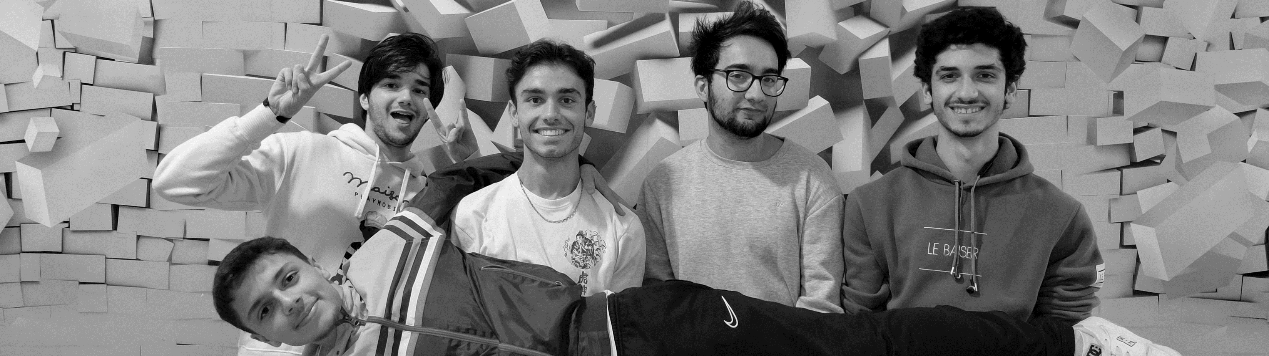
Before PI
After PI
Sérgio Marques
1211705
Very Good
Excellent
Pedro Alves
1211702
Very Good
Excellent
Self-Evaluation
Francisco Gouveia
1201264
Very Good
Excellent
G41
Leonardo Miranda
1200824
Very Good
Excellent
Francisco Marques
1201850
Very Good
Excellent

